Slide 1
What makes you tick?
Increase revenue with targeted marketing and improving click rates
Christopher J. Hill
October 31, 2021

Slide 2
What makes you click?
Increase revenue with targeted marketing and improving click rates
Christopher J. Hill
October 31, 2021

Slide 3
Data
Origins and Manipulations

Slide 4
Data Origins
In house
Id
Timestamp
Clicked
3rd Party - demographics

Slide 5
Cleaning and reliability
Uniform
Few missing values
Area Income 225 records filled with Median Income
High Reliability

Slide 6
Data Transformations
Categorical data created from given data
Day of Week
Time on site
Total Time on internet
Age
Income
Ad Topic Effectiveness
Not Clicked
Notes:
Create “not_clicked” column for counting purposes
Day of Week categories created from given Timestamp
Time Spent categories created from Time Spent on Site
Age categories created from Age
Income categories created from Area Income
Total Time categories created from Daily Internet Usage
Topic line effectiveness categories created from Ad Topic Line

Slide 7
What does the data tell us?
Highlights of demographics of those who click

Slide 8
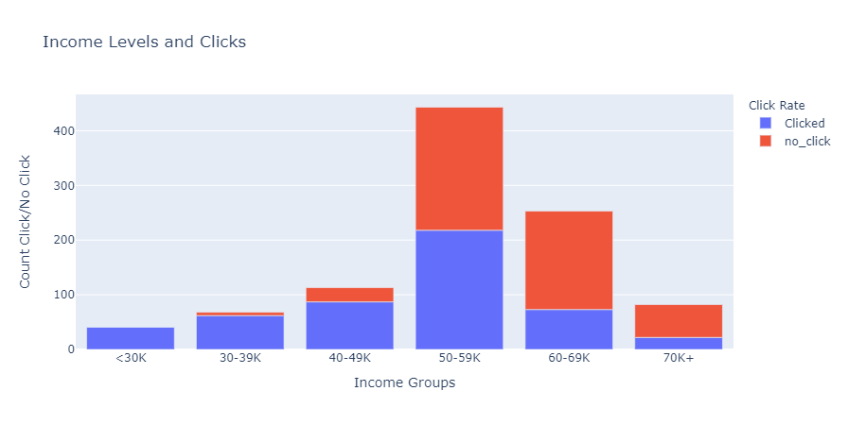
Income under $50K most likely to click

Slide 9
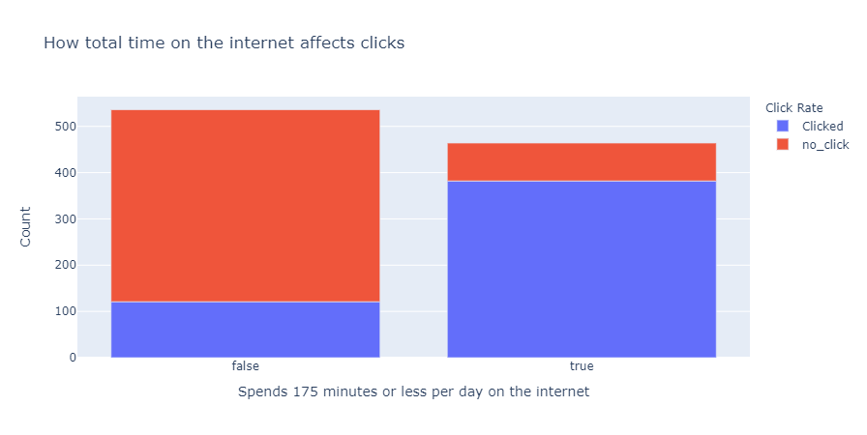
Total Internet Time Less Than 3 Hours will click

Slide 10
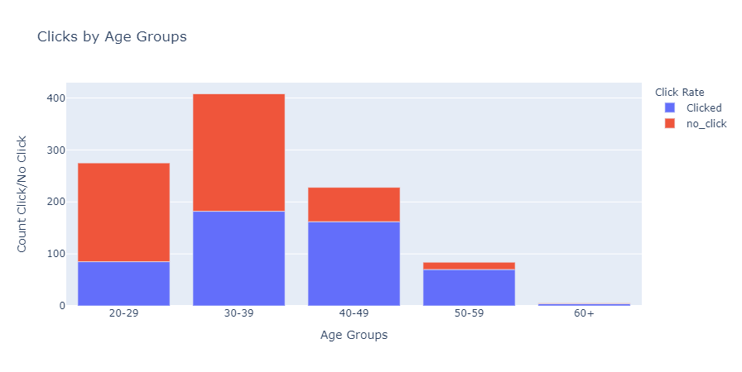
Ages 40 and up have the highest click rate

Slide 11
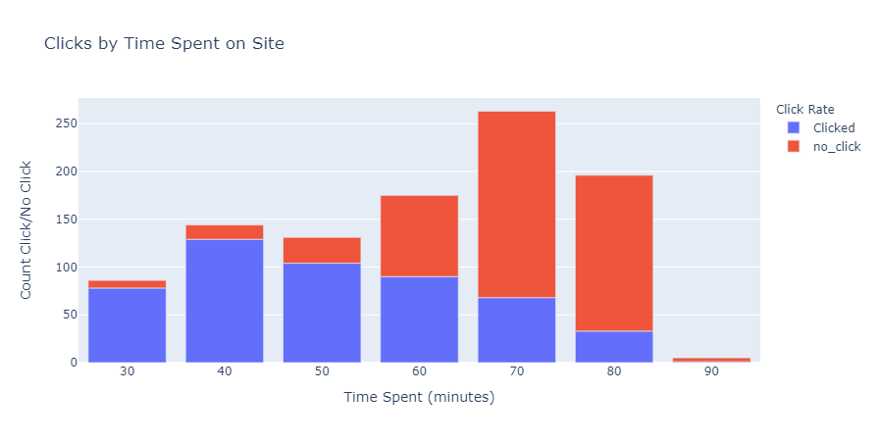
Less than 60 minutes on Site Predicts a Click

Slide 12
Effective Topic Selection
Topic Category | Total Ads | Clicks | Passes
Highly Effective | 52 | 104 | 0
Effective | 326 | 326 | 0
Ineffective | 447 | 73 | 497

Slide 13
Results and Recommendations
Where is the data leading us?

Slide 14
Increase Click Traffic to Targeted groups
94.5%
The accuracy with which my machine learning model can predict a consumer will click on a link

Slide 15
Sell advertising space
Increase ad sales targeting high-click-rate group
Redesign low impact pages to target responsive demographics
Share findings with current advertisers

Slide 16
Collect data on low-click-rate group
Use 3rd party data to discover strategies to reach this group
In-house
Create A/B campaigns to increase effectiveness
Develop surveys for users who leave site without clicking

Slide 17
Appendix
Technical data

Slide 18
Methods
Data came in the form of a csv file
Data imported to Datalore notebook (.ipynb)
Exploratory graphs and analysis with pandas, seaborn, and plotly.exress
Link to code used

